Slide 1
Current Developments in International Religious Freedom
Prof. W. Cole Durham, Jr.
International Center for Law and Religion Studies
Brigham Young University
USA

Slide 2
Global Trends
Religion is a permanent feature of modern society.
It is not “withering away”.
Sociologists recognize that evidence does not support the “secularization thesis”
The trend is toward greater pluralization everywhere
Traditional religions still play very significant role in their countries
Most countries affirm international human rights standards that protect religious freedom

Slide 3
Constitutional Status of Religious Freedom Worldwide
All but ten constitutions on earth have been adopted since World War II.
All international human rights instruments have been adopted in the same period
Freedom of religion or belief has emerged as an axiomatic feature on the constitutional landscape
The right is recognized in the overwhelming majority of the world’s constitutions
This includes virtually every European Constitution and the constitution of every independent country in Latin America

Slide 4
Global Persecution
Study of 143 countries with population greater than 2,000,000 (99% of world)
86% (123 countries) had persecution
36 countries had more than 1,000 cases
25 countries had more than 10,000 cases
Brian Grim and Roger Finke, The Price of Freedom Denied (Cambridge U. Press 2011)

Slide 5
Global Restrictions on Religion
Pew Forum on Religion and Public Life, Report on
Global Restrictions on Religion, December 2009

Slide 6
Religious Restrictions in Twenty-five Largest Countries
Pew Forum on Religion and Public Life, Report on
Global Restrictions on Religion, December 2009

Slide 7
Elder Dallin H. Oaks BYU-Idaho
“There is a battle over the meaning of [religious] freedom. The contest is of eternal importance, and it is your generation that must understand the issues and make the efforts to prevail.”

Slide 8
New Empirical Research
Extension of Pew Research
Protecting Religious Freedom Advances other Social Goods
Empirical Research underscores the importance of religious freedom

Slide 9
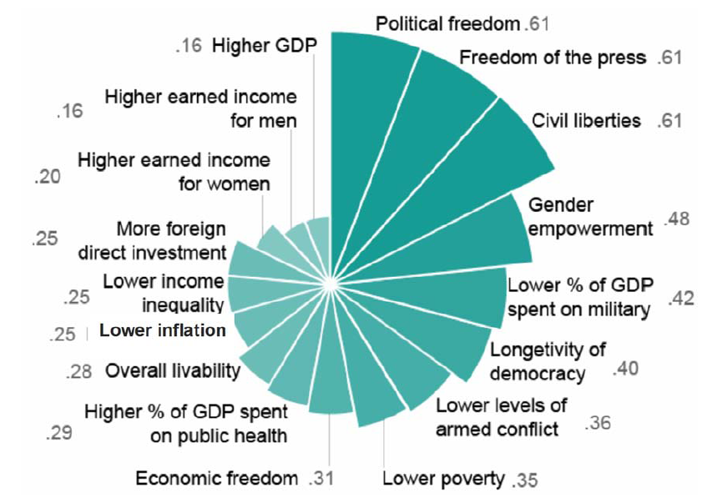
Religious Freedom Correlations
Brian J. Grim and Roger Finke, The Price of Freedom Denied (2011) 206

Slide 10
Government Restrictions on Religion are the Strongest Causal Factor Explaining Religious Violence in Society
It is not the “clash of civilizations” that causes religious violence
Rather, governmental regulation and governmental reinforcement of social hostilities create tensions
Source: Grim and Finke: The Price of Freedom Denied

Slide 11
Grim-Finke Violence Cycle

Slide 13
Key Issues
Conscientious Objection
Religious Autonomy
Defamation of Religion
Religion and the Public Square
Registration
Land Use
Right to Travel

Slide 14
Right to Conscientious Objection
Broader than military
Employment Division vs. Smith: do free exercise rights create exemptions from normal laws?

Slide 15
Two Views of the Place of Conscientious Activity in Legal Orders
Legalist view: the legal system can ultimately be reduced to legislation
Legislation is all the law and all law is legislation
Granting exceptions for conscientious objection would “pulverize” the law and lead to anarchy.
Integrationist view: the legal system includes legislation as adjusted to take constitutional norms into account
Conscientious objection is not a tolerated exception to a general rule
It is an integral part of the rule structure itself.
Conscientious conflicts do not pose a confrontation of private and public, but resolution of two public interests.

Slide 16
14
Alabama |  |  |  | 12
Arizona |  | 11 |  | Arkansas
Connecticut |  | Alaska |  | Delaware
Florida |  | Hawaii |  | Georgia
Idaho |  | Indiana |  | Kansas
Illinois |  | Maine |  | Kentucky
Missouri |  | Massachusetts |  | Louisiana |  |  |  | 6
New Mexico |  | Michigan |  | New Hampshire |  |  |  | Iowa
Oklahoma |  | Minnesota |  | North Carolina |  | 4 |  | Mississippi
Pennsylvania |  | New York |  | North Dakota |  | California |  | Montana |  | 3
Rhode Island |  | Ohio |  | Oregon |  | Colorado |  | Nebraska |  | Maryland
South Carolina |  | Washington |  | South Dakota |  | Utah |  | Nevada |  | New Jersey
Tennessee Texas xas |  | Wisconsin |  | West Virginia |  | Vermont |  | Virginia |  | Wyoming
RELIGIOUS FREEDOM PROTECTION STANDARDS IN THE UNITED STATES
State RFRA & date passed | State’s highest court applies a more protective standard than Smith | State’s highest court has not reviewed a religious freedom case | State’s highest court declines to decide whether or not to follow Smith | State’s highest court follows Smith but does not define how state constitution should be interpreted | State’s highest court follows Smith under state constitution

Slide 17
Religious Autonomy

Slide 18
Layers of the Autonomy Issue
Autonomy in Religious Employment Context: Factual gradations
Institutional continuum
Type of work continuum
Scope of State Deference to Religious Autonomy
Place of Autonomy in constitutional analysis (e.g., as a branch of religion clause analysis)
This will depend on place of religion in public space (jurisdiction, sovereignty, rights)
Relationship of Autonomy to conscience and the underlying conception of law

Slide 19
Decided Cases
Obst v. Germany: LDS head of religious affairs. Appealed termination for adultery to European Court under Article 8 ECHR (Privacy).
Schuth v. Germany: Catholic organist appealed termination for adultery under Article 8 ECHR (privacy).
Siebenhaar v. Germany: school teacher appealed termination from Protestant kindergarten for adherence to Christian sect under Article 9 ECHR (religious freedom).

Slide 20
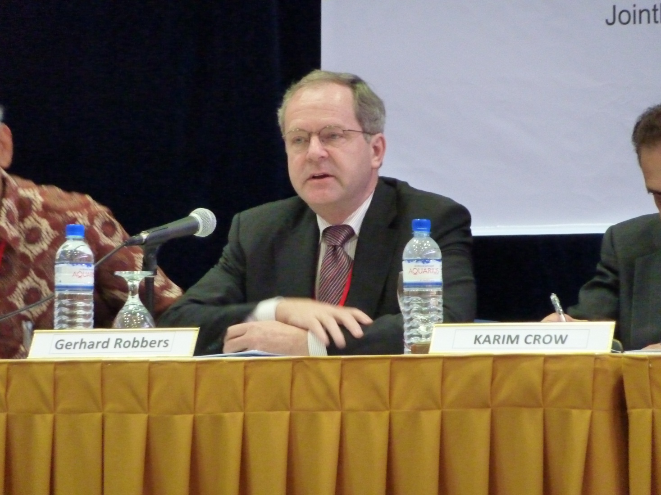
Professor Gerhard Robbers

Slide 21
Defamation of Religion

Slide 22
The Challenge of Protecting Religious Sensitivities
Danish Cartoons
Alarming increase in violence and discrimination based on religion or belief
Proliferation of hate speech targeting religious groups
Insulting speech contributing to Islamophobia

Slide 23
Defamation of Religion Resolutions
UN Human Rights Commission, since 1999
UN Human Rights Council, since 2007
UN General Assembly, since 2005
Resolutions proposed by the OIC in collaboration with Africa group.
Rhetorical Appeal
Declining support: negative votes and abstentions now outnumber positive votes.

Slide 24
Human Rights Commission/Council Votes
Graphic Prepared by Becket Fund for Religious Liberty, USA.

Slide 25
General Assembly Votes
Graphic Prepared by Becket Fund for Religious Liberty, USA

Slide 26
Basic Problems with Defamation of Religion
Implementation of resolutions risks curtailing both
freedom of expression and
freedom of religion or belief
Resolutions are fundamentally at odds with the modern human rights regime
Protection of belief-systems rather than believers
Empowers states to determine permissible theology

Slide 27
Practical Problems with Defamation of Religion Resolutions
Curtailing discussion of religious differences
Chilling effect on religious expression
Autocratic regimes use these norms to oppress dissenters and entrench their own power
Minority and dissenting groups suffer
Hate speech paradox

Slide 28
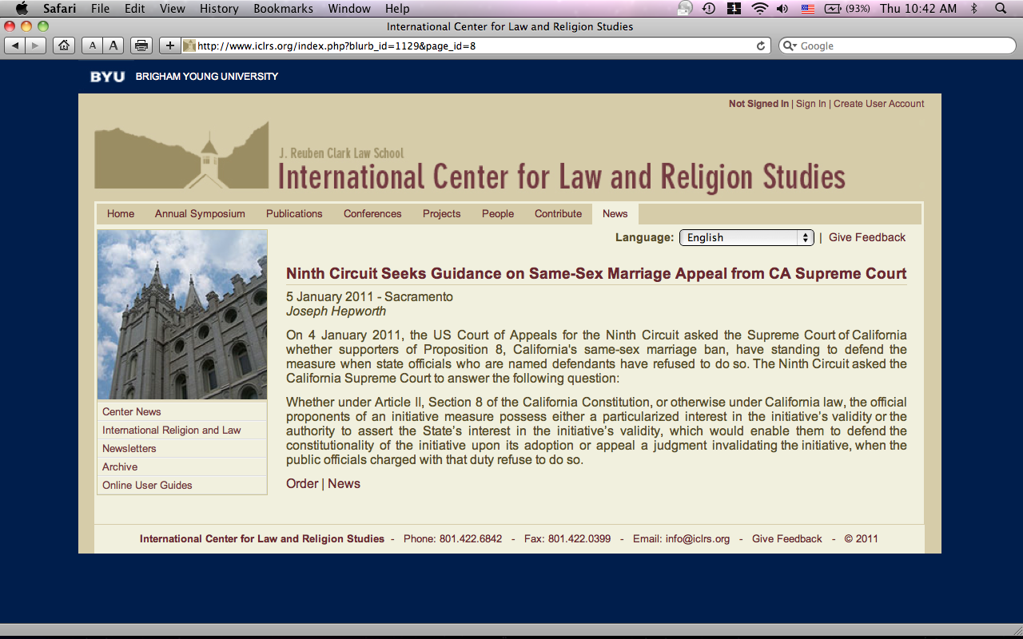
Religion in the Public Square
Efforts to discredit religious voice
Free Exercise Reductionism

Slide 29
Elder Quentin L. Cook
Freedom and light have never been easy to attain or maintain. Since the War in Heaven, the forces of evil have used every means possible to destroy agency and extinguish light. The assault on moral principles and religious freedom has never been stronger. As Latter-day Saints, we need to do our best to preserve light and protect our families and communities from this assault on morality and religious freedom.
--General Conference, October 2010

Slide 30
Sports Analogy
San Diego v. BYU
22,000 attended game.
$10 per student
$23 for other tickets
Yield: $356,000

Slide 31
Cougar Club Basic Levels

Slide 32
Cougar Club Legacy

Slide 33
Constitutional and Legal Impacts
Afghanistan
Albania
Argentina
Armenia
Australia
Azerbaijan
Belarus
Belgium
Bosnia and
Herzegovina
Bulgaria
Chile
China
Columbia
Croatia
Czech Republic
Dominican Republic
Estonia
France
Georgia
Hungary
Indonesia
Iraq
Italy
Japan
Kazakhstan
Kyrgyzstan
Latvia
Macedonia
Moldova
Nepal
Nigeria
Peru
Romania
Russia
Rwanda
Samoa
Serbia
Slovakia
Slovenia
Spain
Tajikistan
Thailand
Turkmenistan
Ukraine
United States
Vietnam

